Slide 1
Java Servlets 3.0
Lesson 02: Working with WildFly
8.x
Notes:
Add instructor notes here.

Slide 2
Lesson Objectives
Configuring the Server with Eclipse Luna ( 4.4.x )
Understanding the Directory Structure
Deploying the Web Application on Wildfly
Notes:
Explain the lesson coverage
Lesson Objectives:
This lesson introduces Web application concepts. The lesson contents are:
Lesson 02: Working with WildFly 8.x
2.1: Configuring the Server with Eclipse Luna ( 4.4.x )
2.2: Understanding the Directory Structure
2.3: Deploying the Web Application on Wildfly

Slide 3
2.1: Configuring the Server with Eclipse Luna ( 4.4.x) Steps for installing WildFly
Steps for installing WildFly
Require JDK 7 or Higher
Set the JAVA_HOME environment variable to the location of JDK 7 or higher or this could be done by setting the path variable.
Identify the drive/location on the system for installing WildFly
Notes:
Before installing WildFly ensure that the system satisfies certain pre-requisites.
Check the availability of JDK 8. Check the version of JDK by using the command
java –version
Set the JAVA_HOME variable to the location of JDK 8 or setting path variable
Identify the drive/location on the system for installing WildFly
(Note : It does not matter where WildFly is installed on the system. However do not install WildFly in a directory that contains spaces, it can cause problems sometimes)
Mention software requirements for installing WildFly

Slide 4
2.1: Configuring the Server with Eclipse Luna ( 4.4.x) WildFly installable
Download WildFly
Latest version can be downloaded from http://wildfly.org/downloads
The zip version can be downloaded from here
Basic installation : Extracting the contents of the archive to an appropriate location identified
Follow below steps for Wildfly Eclipse Plugin:
Select "Help->Eclipse Marketplace..." from the Eclipse menu bar. Choose "Eclipse Marketplace" if prompted for a marketplace catalog.
Search for "JBoss Tools" and install JBoss Tools (Luna), version 4.2.x.
Wait until "Calculating requirements..." has finished and make sure that all features are checked, then confirm.
Accept the license agreements and click "Finish".
Notes:
WildFly Server is freely downloadable. An evaluation copy could also be used
WildFly archive(Zip, tar) can be downloaded from http://wildfly.org/downloads
Once the required version is downloaded basic installation can be done. Extract the contents of the archive in the appropriate location identified on the system.
Official site from where WildFly can be downloaded

Slide 5
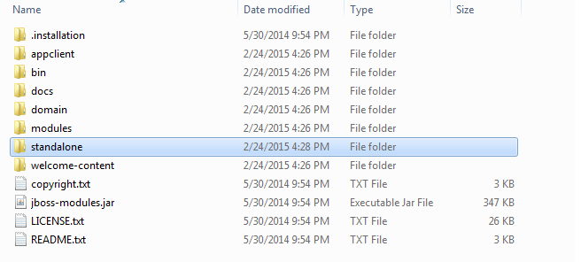
2.2: Understanding the Directory Structure WildFly Directory Structure
WildFly server directory structure
Notes:
Once WildFly is available on the system, it will create the directory that contains server configurations , JARs and other directories which help in functioning of WildFly.
The figure on the slide shows the WildFly directory structure with below diagram
Apart from showing the diagrammatic representation of WildFly directory structure. Also tell the participants to see the structure on their machines and briefly look at even the files contained in the directory

Slide 6
2.2: Understanding the Directory Structure WildFly Directory Structure
Standalone Directory Structure
In "standalone" mode each WildFly 8 server instance is an independent process. The configuration files, deployment content and writable areas used by the single standalone server run from a WildFly installation.
Notes:
The details of the standalone directory is present in below diagram
As WildFly is not used in the clustered environment, focus on the standalone directory structure where single instance of WildFly server is started.

Slide 7
2.2: Understanding the Directory Structure WildFly Configurations
Standalone Server Configurations
standalone.xml (default)
Java Enterprise Edition 7 web profile certified configuration with the required technologies
standalone-ha.xml
Java Enterprise Edition 7 web profile certified configuration with high availability
standalone-full.xml
Java Enterprise Edition 7 full profile certified configuration including all the required EE 7
technologies
standalone-full-ha.xml
Java Enterprise Edition 7 full profile certified configuration with high availability
Notes:
We also have the Domain Server Configurations
domain.xml
Java Enterprise Edition 7 full and web profiles available with or without high availability
Important to note is that the domain and standalone modes determine how the servers are managed not what capabilities they provide.

Slide 8
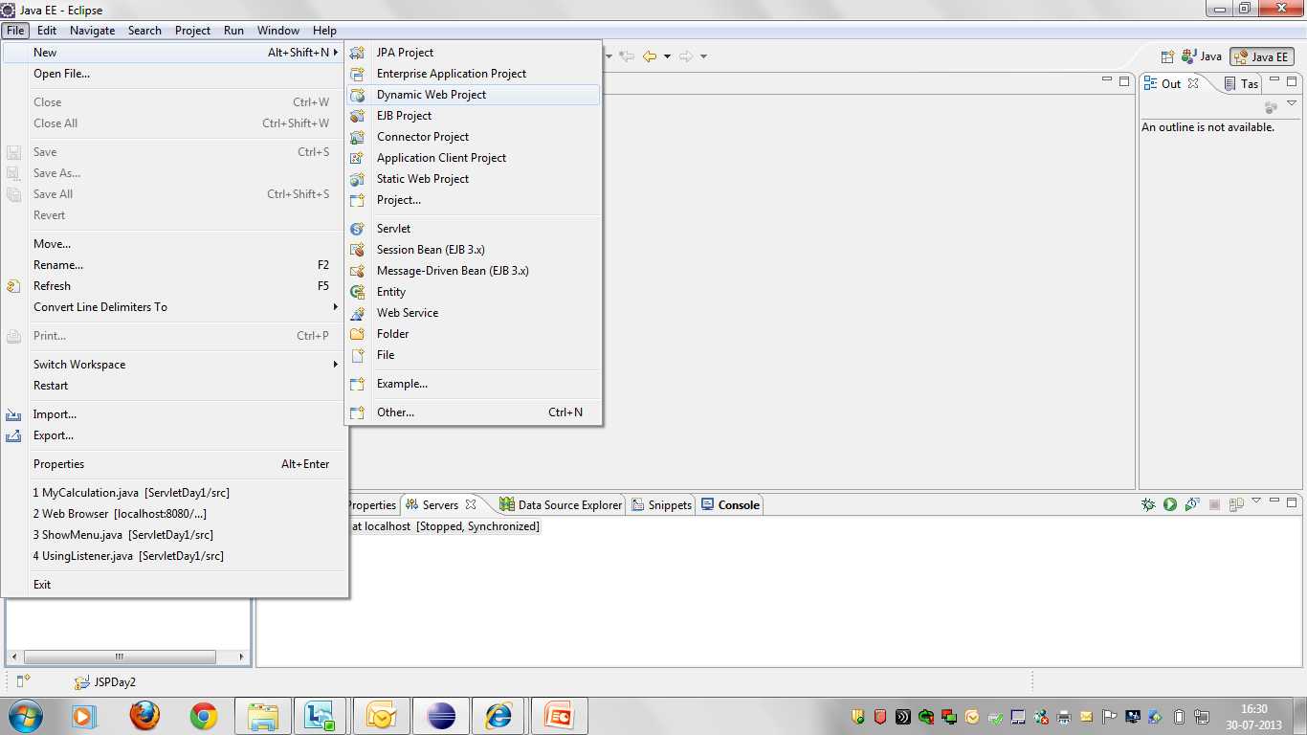
2.3: Deploying the Web Application on Wildfly Using WildFly in Eclipse environment
Create dynamic web project
Notes:
Select Dynamic Web Project
Configuring WildFly with Eclipse editor

Slide 9
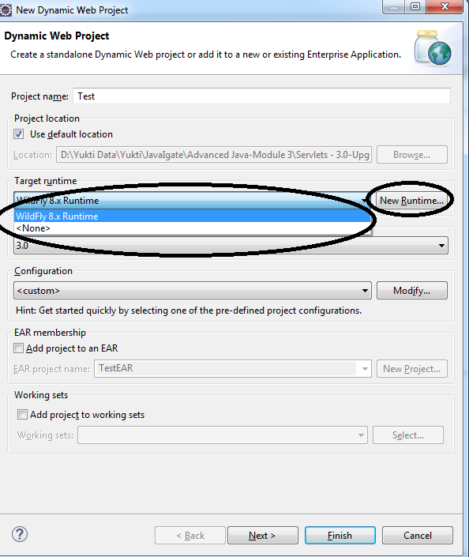
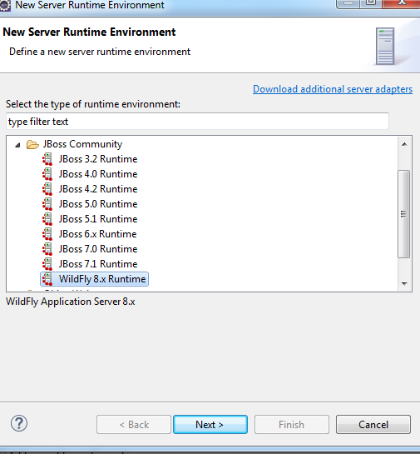
2.3: Deploying the Web Application on Wildfly Using WildFly in Eclipse environment
If Target Runtime is already configured ,then select same and proceed.
If <None> in Target Runtime then select New Runtime
Notes:
Click New Runtime to add server
Configuring WildFly with Eclipse editor

Slide 10
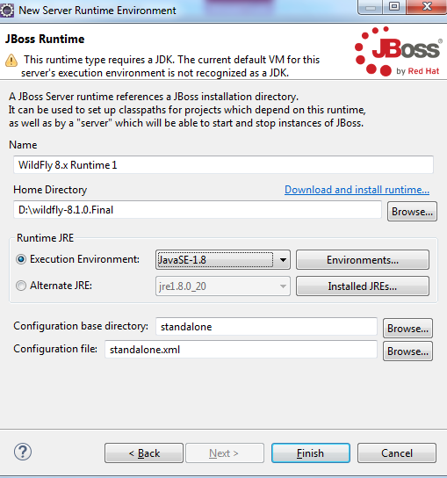
2.3: Deploying the Web Application on Wildfly Using WildFly in Eclipse environment
Select WildFly folder
Notes:
Select WildFly folder
Configuring WildFly with Eclipse editor

Slide 11
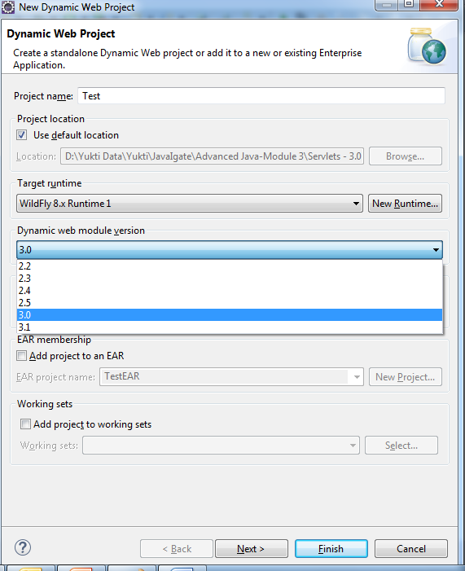
2.3: Deploying the Web Application on Wildfly Using WildFly in Eclipse environment
Click Next > Next > on this screen
Notes:
Select Dynamic web module version 3.0
Configuring WildFly with Eclipse editor

Slide 12
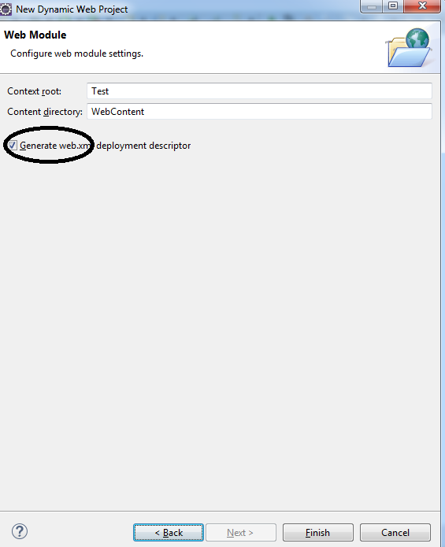
2.3: Deploying the Web Application on Wildfly Using WildFly in Eclipse environment
Click on check box for web.xml and then on Finish
Notes:
Configuring WildFly with Eclipse editor

Slide 13
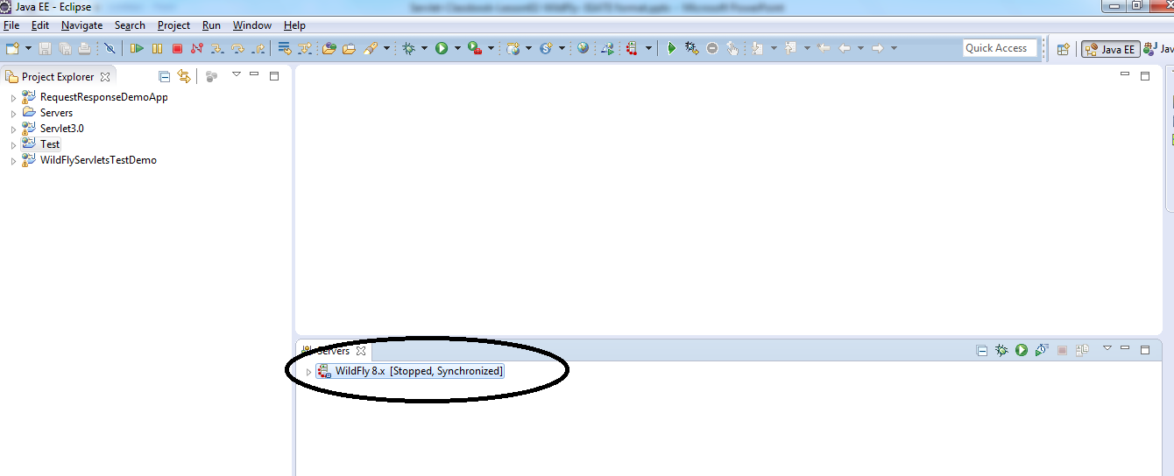
2.3: Deploying the Web Application on Wildfly Using WildFly in Eclipse environment
Notes:
Double click highlighted link to start server
Configuring WildFly with Eclipse editor

Slide 14
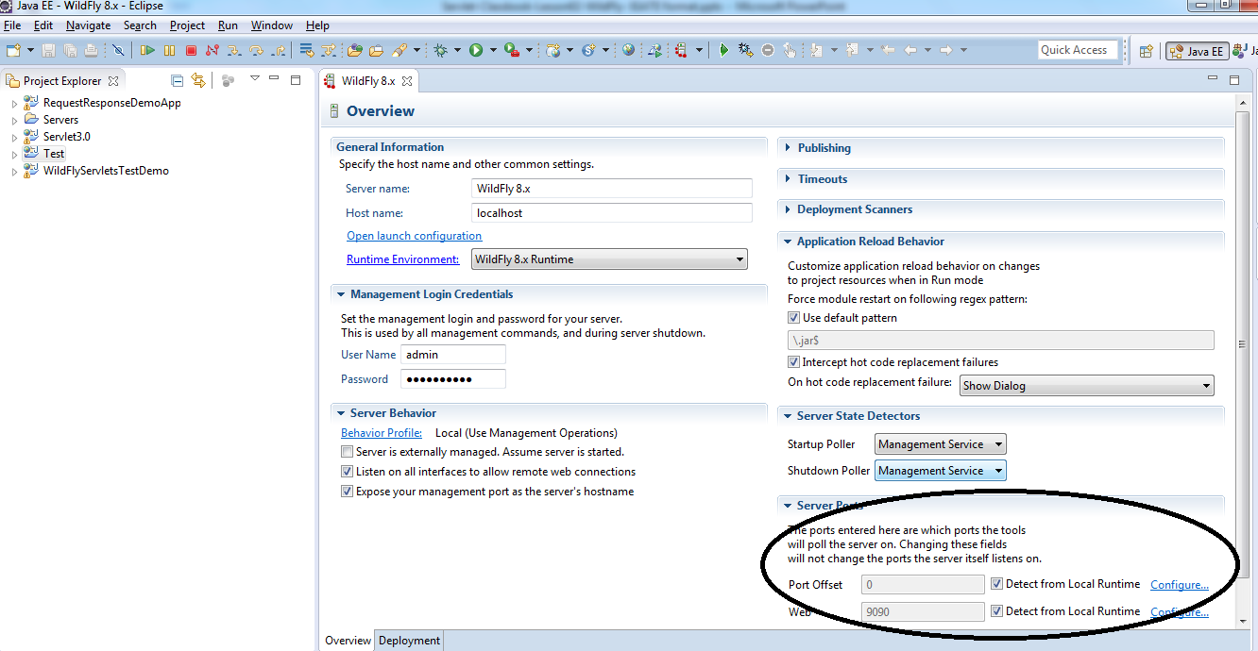
2.3: Deploying the Web Application on Wildfly Using WildFly in Eclipse environment
Notes:
Default port number of WildFly is 8080. In the above configuration localhost port number has been set to 9090. (could be also set from standalone.xml file (D:\wildfly-8.1.0.Final\standalone\configuration)).
See below diagram
Configuring WildFly with Eclipse editor

Slide 15
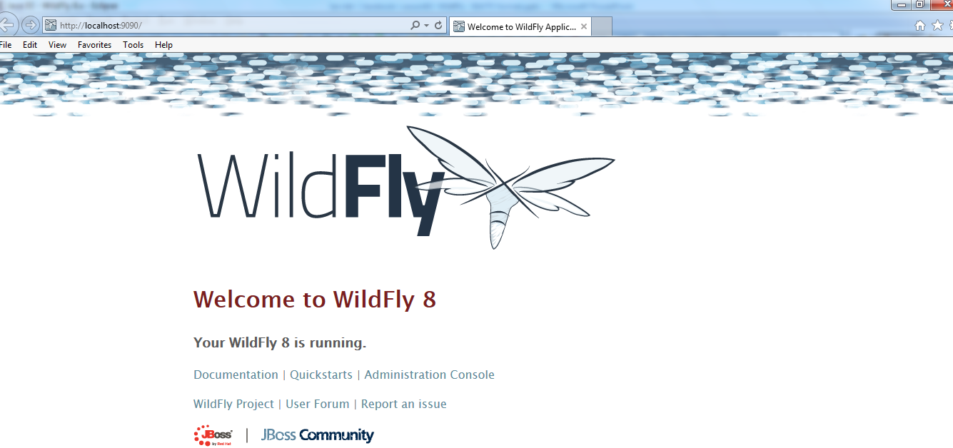
2.3: Deploying the Web Application on Wildfly WildFly - Home Page
Start the WildFly server
The home page of WildFly can be accessed by specifying the URL http://localhost:9090.
The home page can be seen
Notes:
Apart from showing the diagrammatic representation. Also tell the participants to see the JMX Console on their machines and briefly look at even the files contained in the directory. This is the first page on starting WildFly server.
The default port number is 8080. But port number is changed here to 9090 due to conflict with other services

Slide 16
Summary
Installing WildFly
Accessing the WildFly Homepage
Notes:
Add the notes here.
Summarize the points discussed

Slide 17
Review Questions
Question 1: If an independent instance of WildFly required then which mode should be selected
Option 1: Basic
Option 2: Domain
Option 3: Standalone
Option 4: None of the above
Question 2: All configuration information for running the server is located here and it is single place for configuration modifications for the standalone server
Option 1: data
Option 2: configuration
Option 3: log
Option 4: conf
Notes:
Add the notes here.
Answers 1: Standalone
Answer 2: configuration

